Slide 1
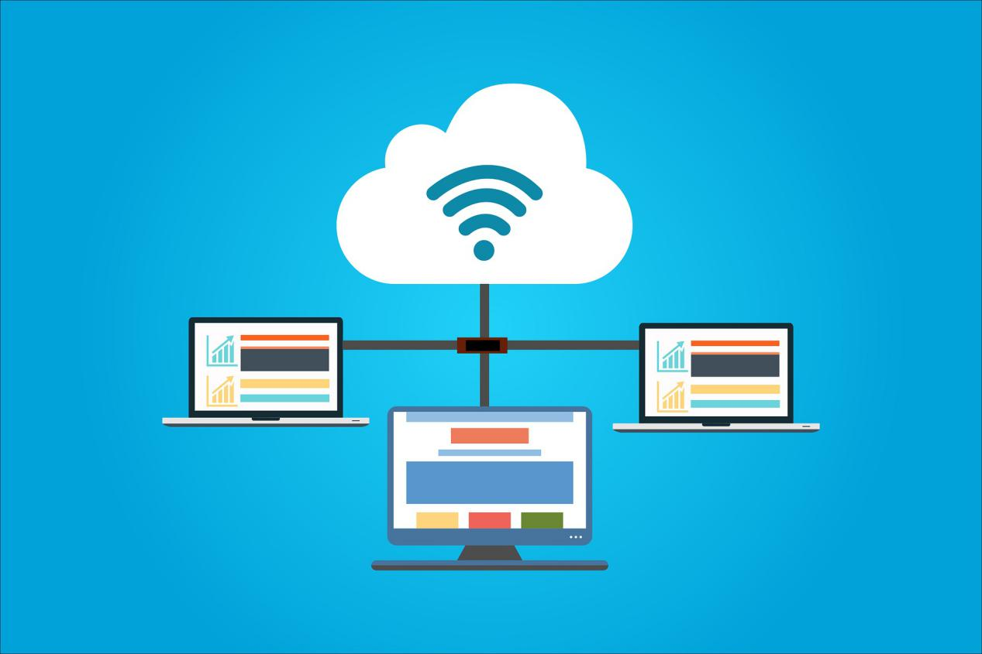

Low Cost Education System

Slide 2
Heterogeneity & Usability
The user facing client should support iOS, Android, Windows, and Linux based operating systems.
The system should provide all users (students and teachers) functionalities through a single client facing application.

Slide 3
Security
The system should be capable of providing of role based (teacher, student, etc.) access control.

Slide 4
Supported Applications Diversity
The OS streams should be capable of supporting a web browser and a suite of desktop productivity applications (i.e. word processor, spreadsheet software, presentation software, and lightweight IDE)

Slide 5
Reliability
On accidental/unintended user disconnect(s), the system should be capable of re-establishing the connection to the same OS stream without losing user state (as long as an adequate internet connection exists).
Re-connect should occur in less than 10 seconds upon internet connection re-establishment.

Slide 6
Application Level Permissions
The system should provide teachers with the ability to grant/revoke application permissions (on an OS container) per student.

Slide 7
Notifications
The teacher should be able to send notifications to students’ clients. Notifications should be received within 10 seconds of being sent.

Slide 8
Student Birds’ Eye View
The teacher should be able to see the screens of all students actively streaming with at most a 10 second delay.

Slide 9
Connectivity State Management
The system should be capable of recognizing active/failed OS container states within one minute of becoming active/inactive. It should also add/remove containers in the allocation pool for users accordingly.

Slide 10
Screen Sharing
The teacher should be capable of sharing their screen with their students.

Slide 11
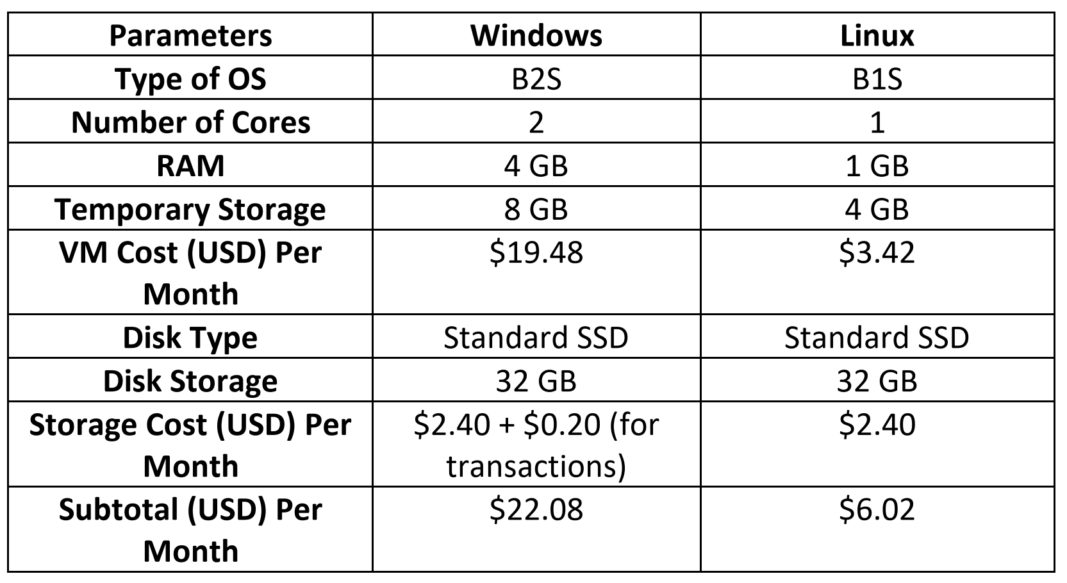
Cost Effectiveness
The full cost of the system per user should not exceed $75 per year which is cheaper than the cost of a system with similar specifications.
Looking at the Subtotal row, the cost for the usage of three Windows and three Linux VMs is $22.08 + $6.02 = $28.09 USD per month. Dividing this by 6 students, each student cost will be $4.68 USD per month. Multiplying this cost by 12 months, each student cost will be $4.68*12 = $56.18 per year.
Total Cost Per Year = 56.18 + 49.99/4 + 19.99/4 = $73.68 (per person)

Slide 12
Portability
The device should be capable of fitting in a standard backpack (17”x9”). The weight of the device should be less than 600 grams.
Params
Weight | 299.4 grams
Dimensions | 192 mm x 115 mm x 9.6 mm

Slide 13
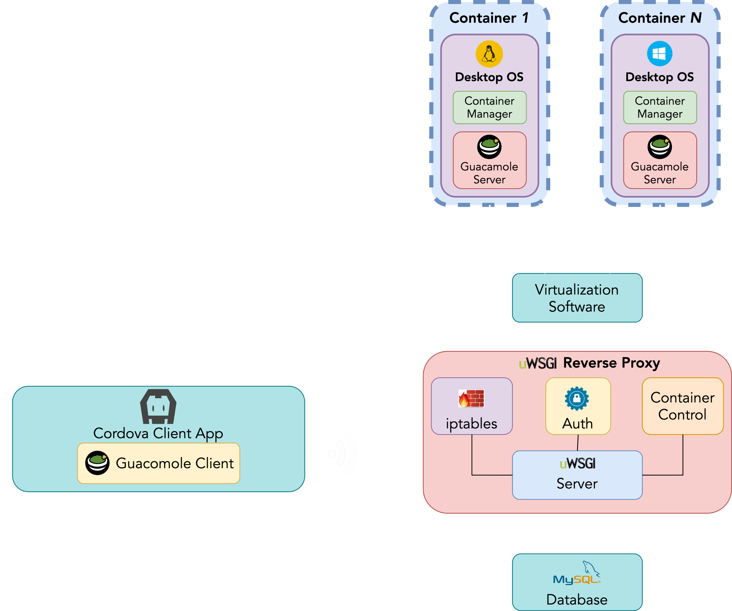
OS Container Isolation
The OS container should be network isolated such that only the Reverse Proxy should be able to directly communicate with the OS container.

Slide 14
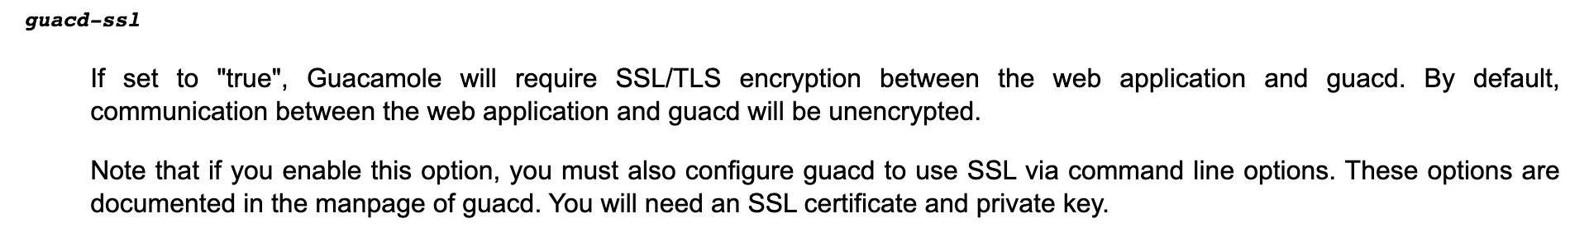
Secure Tunnel for Streaming
The streaming client and server use an encrypted tunnel to transfer data packets
https://guacamole.apache.org/doc/gug/configuring-guacamole.html

Slide 15

Questions?

